Slide 1
Update Operators

Slide 2
updateOne() and updateMany()
The .updateOne() method updates a single document that satisfies a given filter.
db.users.updateOne( { name: “Bob"}, { $set: { course: “CSE"}, $currentDate: {lastModified:true } })
The .updateMany() method updates all documents that satisfy a specific filter criteria.
db.employees.updateMany({ salary: 70000 }, { $set: { salary: 85000 }})

Slide 3
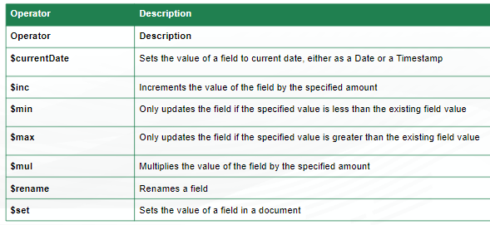
Update operators
To update a document, MongoDB has many in-built update operators. These operators are to be used for passing the updated form of the document to the update methods.

Slide 4
$inc operator
The $inc operator increments a field by a specified value.
Syntax: { $inc: { <field1>: <amount1>, <field2>: <amount2>, ... } }
To specify a <field> in an embedded document, use dot notation.
The $inc operator accepts positive and negative values.
If the field does not exist, $inc creates the field and sets the field to the specified value.
Use of the $inc operator on a field with a null value will generate an error.

Slide 5
db.updateopr.insertMany(
{_id: 1, qty: 20, wt:25},
{_id: 2, qty: 15, wt: 45},
{_id: 3, qty: 40, wt:30},
{_id: 4, qty: 25, wt: 35}
)
Write the queries for the following:
Question1: Increase the value of field qty by 2 for _id:1
Question2: Decrease the value of field qty by 2 and increase the wt by 5 for _id:2
Question3: Increase the value of field qty by 5 and wt by 5 for all documents
Question4: Increase the value of field qty by 5 and wt by 5 for documents with _id:2, _id:4.
Answers:
Query1: db.updateopr.updateOne({_id:1}, {$inc:{qty:2}})
Query2: db.updateopr.updateOne({_id:2}, {$inc:{qty:-2, wt:3}})
Query3: db.updateopr.updateMany({}, {$inc:{qty:5, wt:5}})
Query4: db.updateopr.updateMany({$or:[{_id2},{_id:4}]}, {$inc:{qty:5, wt:5}})

Slide 6
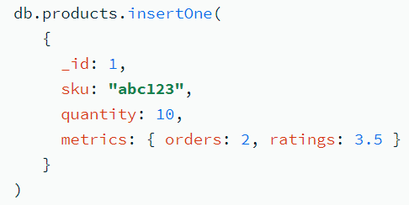
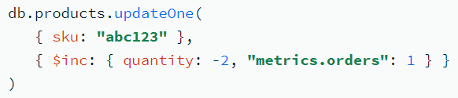
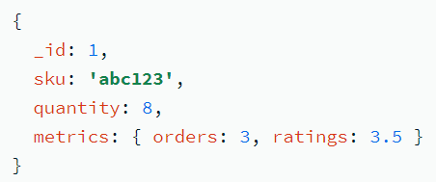
In this example updateOne() operation uses the $inc operator to:
increase the "metrics.orders" field by 1
increase the quantity field by -2 (which decreases quantity)
Query:
Output:
Example: (For Embedded Document)

Slide 7
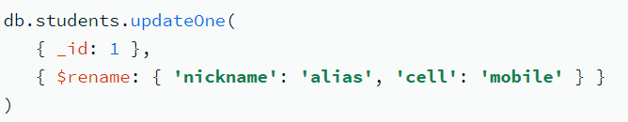
$rename operator
The $rename operator updates the name of a field.
Syntax:
{$rename: { <field1>: <newName1>, <field2>: <newName2>, ... } }
The new field name must differ from the existing field name.
To specify a <field> in an embedded document, use dot notation.
Example:
This operation renames the field nickname to alias, and the field cell to mobile.

Slide 8
The $rename operator logically performs an $unset of both the old name and the new name, and then performs a $set operation with the new name.
As such, the operation may not preserve the order of the fields in the document; i.e. the renamed field may move within the document.
If the document already has a field with the <newName>, the $rename operator removes that field and renames the specified <field> to <newName>.
If the field to rename does not exist in a document, $rename does nothing (i.e. no operation).
For fields in embedded documents, the $rename operator can rename these fields by using dot operator. $rename does not work if these fields are in array elements.

Slide 9
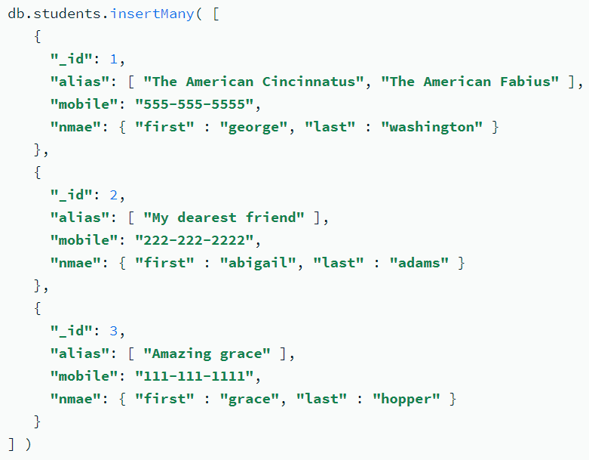
Rename a Field
Rename a Field That Does Not Exist

Slide 10
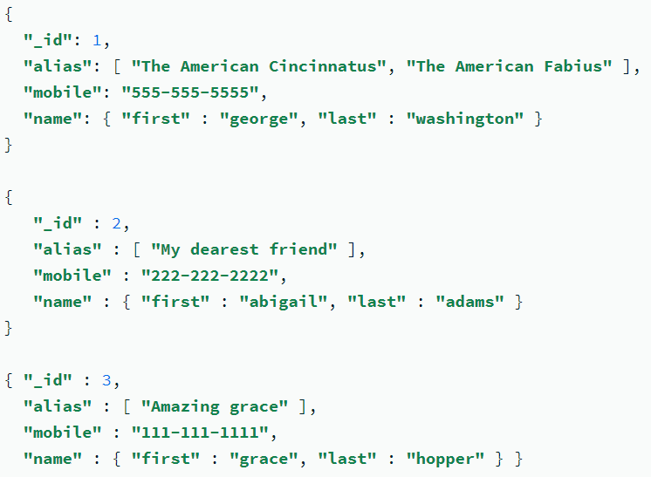
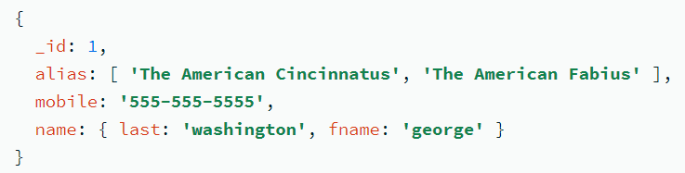
Rename a Field in an Embedded Document

Slide 11
$mul operator
Multiply the value of a field by a number. To specify a $mul expression, use the following prototype:
Syntax: { $mul: { <field1>: <number1>, ... } }
The field to update must contain a numeric value.
To specify a <field> in an embedded document or in an array, use dot notation.
If the field does not exist in a document, $mul creates the field and sets the value to zero of the same numeric type as the multiplier.
Query: Multiply the price field by 1.25 and the quantity field by 2.

Slide 12
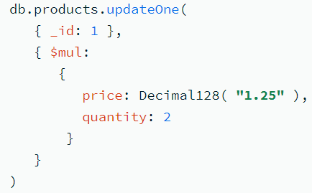
Multiply the Value of a Field
Query: Multiply the price field by 1.25 and the quantity field by 2.
In the updated document:
price is the original value, 10.99, multiplied by 1.25
quantity is the original value, 25, multiplied by 2

Slide 13
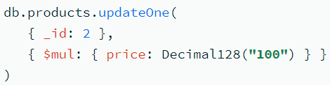
Apply $mul Operator to a Non-existing Field
This query attempts to apply the $mul operator to a field that is not in the document.
The db.collection.updateOne() operation results:
inserts the price field
sets Decimal128("0").

Slide 14
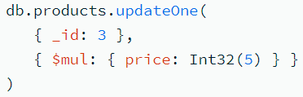
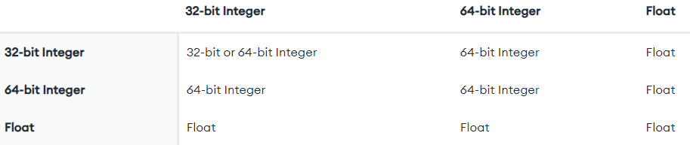
Multiply Mixed Numeric Types
Query: uses the $mul operator to multiply the value in the price field Decimal128(10) by Int32(5):
The value in the price field is of type Decimal128.
Mixed Type: Multiplication with values of mixed numeric types (32-bit integer, 64-bit integer, float) may result in conversion of numeric type. For multiplication with values of mixed numeric types, the following type conversion rules apply:
Output:

Slide 15
$set operator
The $set operator replaces the value of a field with the specified value.
Syntax: { $set: { <field1>: <value1>, ... } }
To specify a <field> in an embedded document or in an array, use dot notation.
Examples:
db.users.updateOne( { name: “Bob"}, { $set: { course: “CSE"}})
db.employees.updateMany({ salary: 70000 }, { $set: { salary: 85000 }})
If the field does not exist, $set will add a new field with the specified value.
If specifying multiple field-value pairs, $set will update or create each field.

Slide 16
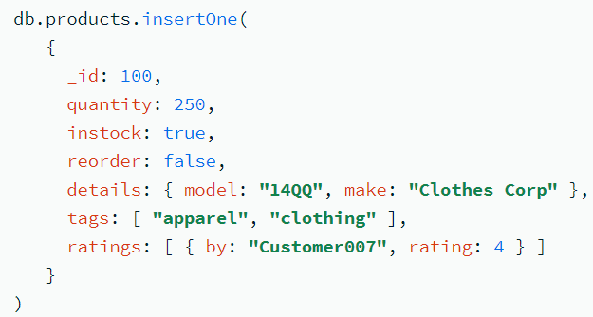
Set Top-Level Fields
Query: For the document matching the criteria _id equal to 100, use the $set operator to
update the value of the quantity field to 500
details field with new embedded document containing field model with value 2600 and field make with value Fashionaires
the tags field with new array elements: coats, outerwear and clothing.

Slide 17
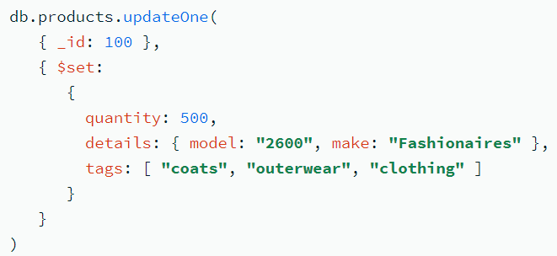
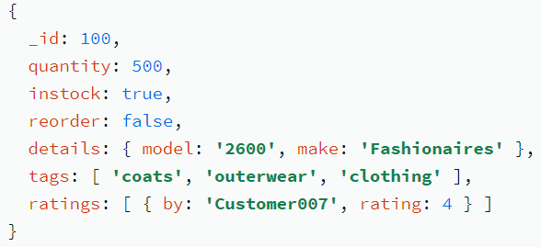
Query:
Output:

Slide 18
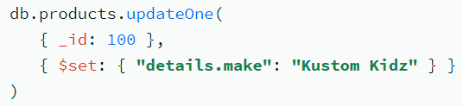
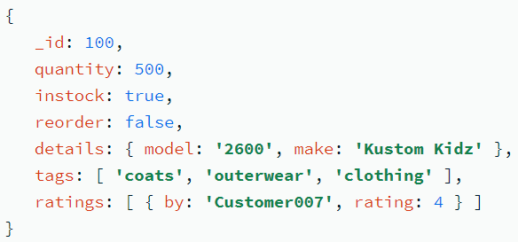
Set Fields in Embedded Documents
To specify a <field> in an embedded document or in an array, use dot notation.
Query: For the document matching the criteria _id equal to 100, updates the make field in the details document.
Output

Slide 19
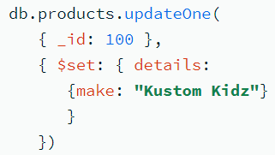

Replaces the entire embedded document, removing all other fields in the embedded details document.

Slide 20
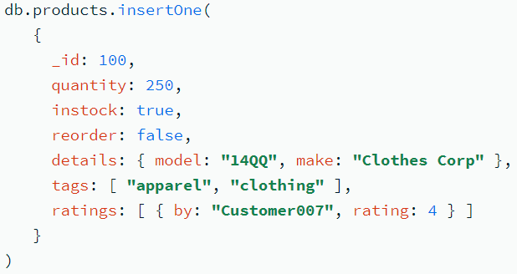
Set Elements in Arrays
To specify a <field> in an embedded document or in an array, use dot notation.
Query: For the document matching the criteria _id equal to 100, update the value of second element of the tags field and the first element of the rating field in the ratings array.

Slide 21
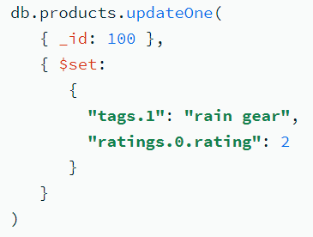
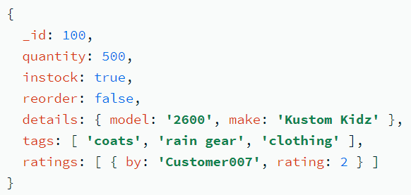
Query: For the document matching the criteria _id equal to 100, update the value of second element of the tags field and the first element of the rating field in the ratings array.
Output

Slide 22
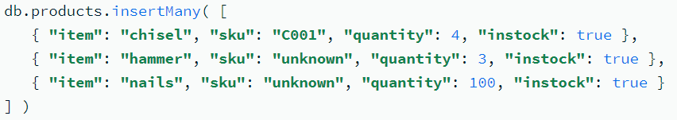
$unset Operator
The $unset operator deletes a particular field.
Syntax: { $unset: { <field1>: "", ... } }
The specified value in the $unset expression (i.e. "") does not impact the operation.
To specify a <field> in an embedded document or in an array, use dot notation.
If the field does not exist, then $unset does nothing (i.e. no operation).
Update the first document in the products collection where the value of sku is unknown.
remove the quantity field
remove the instock field

Slide 23
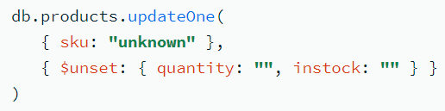
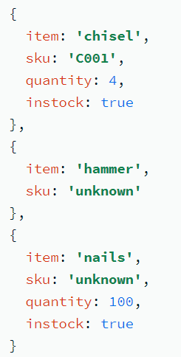

Slide 24
$currentDate
The $currentDate operator sets the value of a field to the current date, either as a Date or a timestamp. The default type is Date.
Syntax: { $currentDate: { <field1>: <typeSpecification1>, ... } }
<typeSpecification> can be either:
a boolean true to set the field value to the current date as a Date, or
a document { $type: "timestamp" } or { $type: "date" } which explicitly specifies the type. The operator is case-sensitive and accepts only the lowercase "timestamp" or the lowercase "date".
If the field does not exist, $currentDate adds the field to a document.

Slide 25
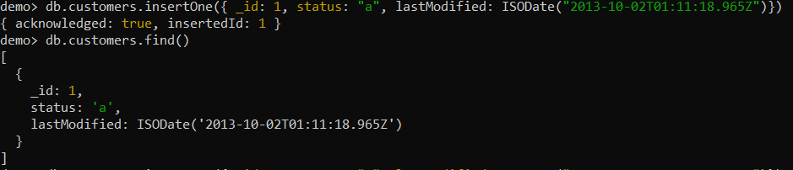
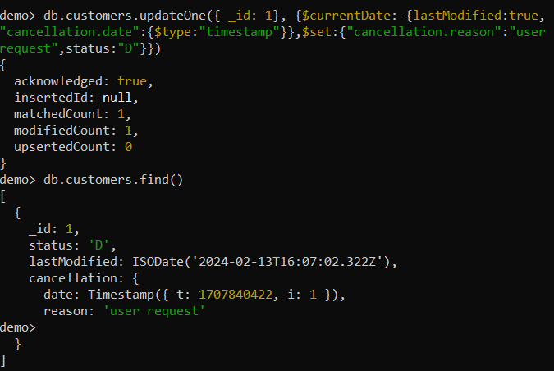
The following operation updates the lastModified field to the current date, the "cancellation.date" field to the current timestamp as well as updating the status field to "D" and the "cancellation.reason" to "user request".

Slide 26
$min operator:
The $min updates the value of the field to a specified value if the specified value is less than the current value of the field.
Syntax: { $min: { <field1>: <value1>, ... } }
If the field does not exist, the $min operator sets the field to the specified value.
Example 1: Use $min to Compare Numbers
The lowScore for the document currently has the value 200.
This operation uses $min to compare 200 to the specified value 150 and updates the value of lowScore to 150 since 150 is less than 200.

Slide 27
Example 2:
Query:
This operation has no effect since the current value of the field lowScore, i.e 200, is less than 250.
Output:

Slide 28
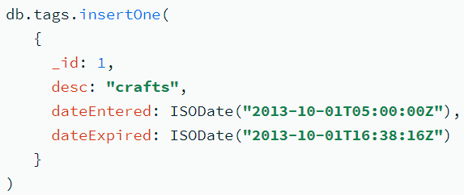
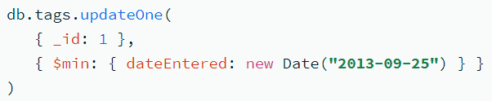
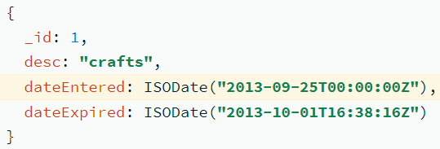
Use $min to Compare Dates
Create the tags collection:
This operation compares the current value of the dateEntered field, i.e. ISODate("2013-10-01T05:00:00Z"), with the specified date new Date("2013-09-25") to determine whether to update the field.

Slide 29
$max Operator:
The $max operator updates the value of the field to a specified value if the specified value is greater than the current value of the field.
Syntax: { $max: { <field1>: <value1>, ... } }
If the field does not exists, the $max operator sets the field to the specified value.
Use $max to Compare Numbers
The highScore for the document currently has the value 800. The following operation:
Compares the highscore, 800, to the specified value, 950.
Updates highScore to 950 since 950 is greater than 800.

Slide 30
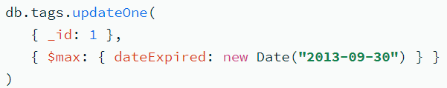
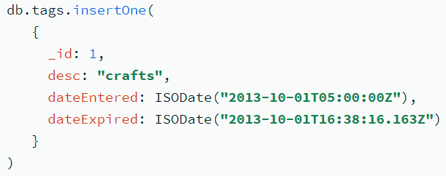
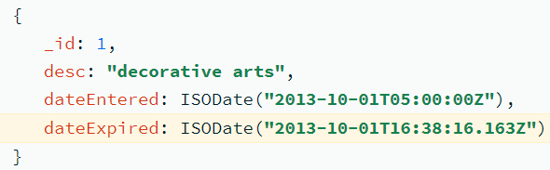
Use $max to Compare Dates
Create the tags collection:
This operation compares the current value of the dateExpired field, ISODate("2013-10-01T16:38:16.163Z"), with the specified date new Date("2013-09-30") to determine whether to update the field.
new Date("2013-09-30") is not the newest date, so the operation does not update the dateExpired field.

